Slide 1
Industry Day – Madrid, Spain
Border Delivery Group
18 July 2019

Slide 2
Event Overview & Objectives
Stella Jarvis – Director, Border Delivery Group
Heather Jones – Deputy Director, Border Deliver Group, SouthEast & Europe
Notes:
Thanks to Simon Manley for inviting us here today
Good morning and welcome to our first Industry day event here in Spain.
We are pleased to see so many businesses here with us today

Slide 3
Plan for the day
overall_0_131891685038941810 columns_1_131891624544849165 4_1_131891649206487158
1
Planning assumptions and trader readiness
2
Details on the four key processes from HMG Departments:
Customs applications & requirements
Food, animals, plants and other controlled goods
Transport requirements
Product conformity and standards
3
Comms plan and next steps
4
Infrastructure at the short straits – external stakeholder panel
Eurotunnel
DFDS Ferries
P&O Ferries
Brittany Ferries
5
Presentations by Spanish Officials
Notes:
Today is about sharing information with you, to help you prepare to move goods in and out of the UK as efficiently as you do today.
Focussing on businesses who have only traded within the EU to date.
Today is not only about the short straits crossings, we will look at all freight movements between UK and Spain and UK to Spain via Western Channel French ports.
Additionally, we will be providing the opportunity to help traders to prepare at our market stalls – for example, we can generate UK EORI numbers and register you for transitional simplified procedures (TSP) today if you are eligible to apply.

Slide 4
UK Brexit position as at 18 July 2019
New PM to be announced 23 July
Theresa May stands down on 24 July and new PM takes office.
Parliamentary recess begins on 25th July 2019.
UK Government is focused on reaching a Deal that can command the support of Parliament so that the UK can leave the EU with a Deal in an orderly way on 31 October 2019.
Until we have a Deal, the default position is that we leave with ‘No Deal’ on 31 October 2019.
Notes:
I would like to share the latest UK Brexit position
As you know some key decisions are still to be confirmed – the date for the announcement of our new PM is 23 July
This is followed shortly by Parliamentary recess which is due to begin on 25th July
The UK Government remains focused on reaching a Deal – until we have a deal the UK’s default position is to leave the EU on 31 Oct 2019

Slide 5
Event overview - Types of freight traffic
Today’s Industry Day will cover three types of freight traffic:
Freight to / from Spain / EU using the Short Straits.
Freight to / from Spain / EU using the western Channel ports.
Freight to / from Spain / EU from south coast direct to Bilbao and Santander.
Notes:
During todays event we will cover 3 types of freight traffic including:
1. Freight to and from Spain and the EU using the Short Straits
2. Freight to and from Spain and the EU using the western Channel ports; and
3. Freight to and from Spain and the EU from south coast direct to Bilbao and Santander
We want to ensure that you have a clear understanding of the steps and processes that you need to take to be able to continue to use these routes in the future
Movement of goods and trade is a key priority
We are here to answer your questions and help you to build confidence – so that you can continue to access systems and trade without disruption – please make sure you use todays event to raise questions and seek confirmation and clarification

Slide 6
UK border priorities
UK Government objectives and priorities for the border
UK will maintain security and prioritise flow, ensuring new controls or processes do not interrupt flow of goods.
Maintaining security
Facilitating the flow of goods (including animals, food and plants) and people
Protection of revenue and compliance with standards
Notes:
The UK Government has 3 key objectives are:
Maintaining security
Facilitating the flow of goods
Protection of revenue – including compliance with standards
Today you will hear about new processes and controls – our key priority when making and introducing these changes is to ensure that we do not interrupt the flow of goods

Slide 7
UK border planning assumptions
UK border planning assumptions are now focussed on trader readiness, and the potential for disruption to RoRo flow in the event of a “No Deal”.
We have revised the original assumptions to reflect that infrastructure & resources (customs / SPS facilities) are now in place in France.
UK Day 1 arrangements do not include any new checks at the border, so will not constrain the flow of RoRo goods into the UK.
Given the nature of the closed loop system at the short straits, there is a risk of disruption to the flow of goods into and out of the UK.
Our current assumptions are:
that less than 50% of freight vehicles will have the correct documents.
If unready trucks travel from the UK, they will have to be processed at the EU border, which may cause blockages and queues.
In order to be ready, customs and SPS declarations must be prepared in advance of arrival at the EU border.
Trucks with complex loads may have multiple consignments.
Notes:
We want to share further clarity on the UK border planning assumptions
Our assumptions are focused on Trader readiness
We have recently revised our assumptions and will continue to review and update these as we gain further intelligence and clarity on how processes will work
We have recently learnt more about the customs and security arrangements that will be in place in France – we need to do all we can to encourage trader readiness
Our current assumptions suggest that less than 50% of freight vehicles will have the correct documents
In order to address this – we want to ensure that traders have registered and have completed customs and SPS declarations in advance of their arrival at the border

Slide 8
Mitigations
3 main mitigations
Implement Brexit Readiness checks
Checks will help to minimise how many unready trucks may cross the channel.
Improve “trader” readiness
Major work on communications over the summer. “Brexit Fatigue” means limited impact until new PM provides more clarity.
Improving traders’ awareness of need for registration, authorisation and financial obligation and time this takes.
Implement traffic management systems
This aims to reduce and disperse traffic build up/queues at key RoRo locations.
Notes:
This slide outlines the 3 main areas of mitigation
We will be undertaking Brexit readiness checks – these checks will help to minimise the number of unready trucks
Improve trader reediness
We will be refreshing and relaunching communications over the Summer period- once our new PM is in post – our new Communication strategy will follow
We are continuing to promote the need for traders to register - this actions needs to happen now as time is running out
We are also looking to implement traffic management systems – the key aim here is to reduce and disperse traffic build up at key RoRo locations
Hand over to Government representatives

Slide 9
End to end customs processes for freight at the border
Margaret Whitby, HM Revenue & Customs

Slide 10
Overview
Currently, businesses can move goods freely between the UK and the EU.
In the event that the UK leaves the EU without a Deal, businesses importing and exporting goods within the EU will have to comply with new rules.
HMRC is committed to helping businesses understand these changes and the actions they need to take to ensure that they remain compliant and can continue trading in the event of a No Deal EU Exit.

Slide 11
Approach to No Deal
Day one easements include
Transitional Simplified Procedures.
Intermediaries’ liability.
Guarantee relaxations.
Entry Summary Declarations for imports.
Day 1
Declarations should be pre- lodged electronically in advance.
Routine fiscal and other controls and checks undertaken away from the flow of traffic.
Longer term
Longer term, UK Government is working on automated solutions, use of technology for smarter borders and sharing more data.

Slide 12
HMRC exports from the UK

Slide 13


Exporting from the UK through RoRo borders on Day 1
Customs and safety/security
exports
Authorised
premise/DEP
Pre-departure
At UK border
Post border
Submit combined Export/ Safety & Security Declaration
Document checks – response provided to exporter
Permission to proceed granted
High risk goods: Obtain full departure message from HMRC or intermediary
Haulier checks in for boarding and takes goods to departure point
Haulier takes goods to DEP; Checks carried out if necessary and Declaration updated
Ferry/train departs
Pre-lodge any supporting documents on relevant system(s)
Exporter tells haulier if Permission to Proceed granted or need to take goods to Designated Export Point (DEP)
Exporter to ensure that the relevant EU member state import, safety and security declarations and any other necessary documents have been made / pre-lodged – and the MRN for that declaration is provided to the hauler to present at check-in at the UK border.
Key: Responsible parties
Business
UK Government

Slide 14
Entry summary declarations for exports (Safety & Security)
Safety & security / ENS information required on export from the UK will continue to be provided as part of the export customs declaration.
We expect that the EU will require a safety & security declaration for imports to the EU, reflecting current rest of the world process.
overall_0_131890129951127481 columns_1_131896072887296470 6_1_131889998640165249 9_1_131889998640376058 25_1_131890006548949768 30_1_131890010047522118 33_1_131890010222844276 37_1_131890018140189422 38_1_131890029732408871 44_1_131890068567785038 27_1_131890129739223457 7_1_131896069413037518

Slide 15
Merchandise in Baggage (MIB) exports
Merchandise in baggage are commercial goods (for trade or business use) where:
A commercial transport operator does not carry them for you.
You’ve travelled to or from the UK carrying goods in your baggage or in a small motor vehicle.
For travellers carrying MIB worth less than the £900 and 1000 kilograms oral declaration limit:
Travellers with commercial goods in an accompanied baggage or a small motor vehicle below £900 and 1000 kilograms that are not classified as controlled goods and not subject to a licence can make a declaration using our simplified online declaration up to 5 working days before they depart the UK irrespective of which port they leave from the UK.
Travellers with commercial goods in an accompanied baggage or a small motor vehicle if the goods are above £900 or weigh more than 1000kgs or are classified as controlled goods or subject to a licence will follow the standard customs export declaration process irrespective of which port they leave from the UK.

Slide 16
HMRC imports into the UK

Slide 17

Importing to the UK through RoRo borders on Day 1
customs
Pre-border
En route
At UK border
After arrival in UK, update status of declaration by close of business next working day
Register for EORI
Goods free to leave
Pre-lodge import declaration to UK Government
Master Reference Number (MRN) or EORI provided to haulier/freight forwarder
Update status of customs to show goods arrived in UK
Risk-based checks, no change from current approach
Goods/ truck referred inland
Businesses can defer payment if:
Paying customs in monthly payments
Using special relief schemes
Duties paid or deferred
Key: Responsible parties
Business
Haulier
UK Government

Slide 18
Transitional Simplified Procedures (TSPs)
Transitional Simplified Procedures will make importing goods easier for the initial period after the UK leaves the EU.
Traders registered for TSP will not need to make full customs declarations at the border and will be able to defer paying their customs duties.
To be eligible, traders must:
Be established in the UK
Have the intention to import goods into the UK from the EU
Have an Economic Operator Registration Identification (EORI) number

Slide 19
TSP declaration process
overall_0_131892000554139829 columns_4_131909273411195331 10_1_131891262934541796 15_1_131892583558466806 16_1_131891999778880718 19_1_131892583809463302 22_0_131897065085022030 23_1_131892000233826264 27_1_131892000339395250 31_1_131892000366811566 35_1_131892000448369215 6_1_131892168074483844 9_1_131898744710416574 37_1_131892168074854168 18_1_131892583558672573 8_1_131897104232460766
Controlled goods
The trader submits a simplified frontier declaration and ensures all necessary certificates and licences are available.
This is followed by a supplementary declaration by the forth working day of the month following the arrival of the goods in the UK.
Standard goods
The trader makes a declaration directly in their commercial records.
This is followed by a supplementary declaration by the forth working day of the month following the arrival of the goods in the UK.

Slide 20
Duty deferment
Current rules
Traders must have a duty deferment account to use TSP or an agent’s Customs Freight Simplified Procedure(CFSP) authorisation:
In practice, this is a direct debit mandate
It allows HMRC to take a monthly payment of duties 15 days after the supplementary declaration is made
Guarantees are required in order to defer duty to make monthly payments
Day 1 easements
Traders will not be required to meet the Customs Comprehensive Guarantee(CCG) criteria when obtaining guarantees.
Traders can still choose to apply for a CCG, as those with Authorised Economic Operator C status can seek a reduction in the level of guarantee required to defer duty.

Slide 21
Merchandise in Baggage (MIB) imports
For travellers carrying MIB worth less than the £900 and 1000 kilograms oral declaration limit:
If they are entering the UK through a port without a Red Channel or Red Phone they will use an electronic form available on GOV.UK, up to 5 days before coming into the UK.
Pre-lodge a simple declaration alongside paying the duty and tax.
The limits apply per vehicle.
Ports without a red channel or red phone are legally defined as: RoRo listed locations and Eurostar terminals.
For travellers carrying MIB worth more than the £900 oral limit:
Pre-lodge a full customs declaration with HMRC directly through existing channels or through a customs agent up to 5 days before arriving into the UK. this will be a requirement at all ports.
The traveller will be given a receipt so that in the event they are stopped by border force as part of their non-fiscal targeted checks, they have evidence of customs declaration and tax payment.
Tor travellers carrying goods subject to excise duty or goods classified as controlled need to pre-lodge a full customs declaration irrespective of whether the goods are above or below £900.

Slide 22
Common Transit Convention (CTC)

Slide 23
How does the Common Transit Convention (CTC) work?
The CTC allows movement of goods - under duty suspense - between the 28 EU Member States and the European Free Trade Association countries (Iceland, Norway, Switzerland and Liechtenstein) plus Turkey, Republic of North Macedonia and Serbia.
UK has been invited to accede to CTC as a separate contracting party when EU laws cease to apply to the UK (letter of invitation was December 2018).
The requirements to use CTC will remain unchanged. However, as the UK will be outside the EU Customs territory, traders will need to have a Transit Accompanying Document (TAD) scanned at the point of entry into the UK or other new customs territory.

Slide 24
Transit and the Common Transit Convention (CTC)
2. Office of Departure
4. Office of Destination
1. Transit declaration
3. Office of Transit
5. Transit closed
The transit declaration is completed (including guarantee) using NCTS (the New Customs Transit System)
The goods are presented at the Office of Departure (or Authorised Consignor) and the Transit Accompanying Document (TAD) is printed off presented to the haulier and then the goods are released into transit.
At every border crossing into a new customs territory, the TAD and goods are presented at the Office of Transit (OoT functions can only be performed by Customs Officials).
At the final destination the goods and TAD are presented at the Office of Destination (or Authorised Consignee).
The transit movement is closed, the goods must be declared to another customs regime eg free circulation, temporary storage and the guarantee is released.
The goods are tracked and messages are sent from the various offices using NCTS during the journey.

Slide 25
Transit guarantees
To make transit movements a trader needs to provide a guarantee for the customs duties suspended during the movement. This can be an individual guarantee for a single movement or a Customs Comprehensive Guarantee (CCG) for multiple movements. To hold a CCG, a business needs to:
Satisfy HMRC’s customs/compliance checks; and
Obtain a guarantee from an approved financial institution.
An individual guarantee can include a guarantor undertaking from a bank or financial institution and a cash deposit.
Guarantees can take several weeks to set up, so traders should contact their bank or insurer about this as soon as possible.
The guarantee requirements are set by the Common Transit Convention.

Slide 26
Simplified transit procedures
Under the CTC, traders can apply for authorisation to use simplified transit procedures. The main types of authorisation are:
Authorised Consignor Status allows traders to declare goods to transit at their premises rather than an Office of Departure. Traders applying for this need to have a CCG.
Authorised Consignee Status allows traders to end transit movements at their premises rather than an Office of Destination. Traders applying for this generally need a temporary storage facility.
HMRC is working to enable traders to be authorised as quickly as possible.

Slide 27
Empty trucks
Entering/leaving the UK
For UK customs purposes there will be no requirement to make a customs declaration for empty lorries.
Packaging
Where an otherwise empty lorry contains some packaging no customs declaration will be required and the lorry will be treated as empty.
This applies to:
Empty containers and pallets
Equipment for controlling the temperature inside the container
Internal partition, shelves and similar for stowing goods
Further details at:
https://www.gov.uk/government/publications/notice-3001-special-procedures-for-the-union-customs-code/annex-c

Slide 28
Special procedures – Day 1
Current rules: EU rules require a customs comprehensive guarantee (CCG) to obtain a full authorisation for a special procedure.
Day 1 easements
Traders will not be required to meet the CCG criteria nor provide a financial guarantee for:
Inward processing
Outward processing
Temporary admission
Authorised use (a.k.a. end use)
Customs warehousing
Traders still need to meet criteria for the special procedure.
This policy will be monitored, and traders will be given 12 months’ notice of changes.

Slide 29
UK enrolment to schemes as at 23 June 2019
EORI
Between December 2018 and 23 June 2019 HMRC received 74,000 applications for EORI numbers.
Around two thirds of the VAT registered businesses that only trade with the EU have registered for EORI numbers.
Transitional Simplified Procedures (TSP)
There have been 18,100 TSP registrations up to 23 June 2019.
The number registered reflects use of other easements and actions, for example use of CFSP and transit.
Number of agents who have applied for the grant scheme
There were 878 applications for customs agents’ training / IT grants through the scheme, requesting the full £5 million available to businesses, by the 31 May 2019 deadline.
AEO data
548 businesses have been granted UK AEO authorisations since 1 June 2016.

Slide 30

Key actions for Spanish businesses
Businesses who trade with the UK need to act now to ensure that they are prepared in the event of a No Deal EU exit.
Apply for an EORI number (UK & EU)
Consider registering for TSP if you are established in the UK.
Confirm you can complete each data field in the declaration.
Agree responsibilities with your customs agent and logistics provider for each part of the process and update your contracts to reflect this.
Identify software for submitting documents, if you do not use a customs agent.

Slide 31
overall_0_131600703271538582 columns_1_131600694444874709
Contact details for HMRC Stakeholder team: externalstakeholders.customs@hmrc.gov.uk
We are hosting an EORI registration stand, available at the market stalls this afternoon.
Any questions

Slide 32
UK Border Force Update
David Smith – Border Force South Eastern Europe

Slide 33
UK Border Force operational resource
Border Force increased its headcount by approximately 900 officers between March 2018 and March 2019.
In addition to specific recruitment for EU exit activities, BF has also recruited a Readiness Task Force (RTF) to provide operational resilience to the front line and allow existing staff to undertake EU exit related training.
As we move towards 31 October our priority is to on-board and train the remaining new appointees.
To prepare all BF Officers for Day 1, a comprehensive set of training and operational guidance about process changes has been rolled out through face-to-face training to all frontline officers across the 5 regions and support teams.

Slide 34
UK Border Force operational changes
‘No Deal’ at RoRo Ports
Border Force is committed to managing control processes in a way which will minimise delays or issues for the flow of trucks through RoRo ports.
Safety & Security: Any vehicle and consignment may be subject to checks at the border, as they currently are for security purposes, under an intelligence-led, risk-based approach. Such checks will continue.
Border Force will not be systematically stopping vehicles as they disembark to ensure they have completed the correct customs declaration.
No need to stop unless pulled out of the flow by Border Force at its selection points. As far as is possible regulatory and fiscal checks will be conducted at locations away from the port.

Slide 35

UK Border Force: Passport Controls
Ensuring a frictionless border from day one will be a priority.
EU nationals will continue to be able to enter the UK as now, using e-Passport gates when travelling on a biometric passport. EU nationals will also be able to enter the UK for short-term visits without a visa.
Until 31 December 2020, EU citizens will be able to enter the UK by showing their valid national identity card for up to three months during which time they will be permitted to work, study or simply visit.
In the event of no deal, and once free movement has ended, EU citizens who wish to stay longer than three months will need to apply to the Home Office for leave to remain within three months of arrival.
EU nationals currently resident in the UK should register now for EU Settled Status to confirm their right of residence beyond 31st October. Those with 5 or more years residence will be granted permanent status immediately. Those with less than 5 years will be granted pre-settled status which can be converted to settled status once 5 years residence is completed.

Slide 36
Sanitary & Phytosanitary Requirements (SPS)
John Furzer (Food Standards Agency)
Matt Abbott (Border Division, EU EXIT, Department for Environment, Food and Rural Affairs)

Slide 37



EU Exit – High-risk food and feed imports
Notes:
Background
All products imported into the UK must comply with EU law on contaminants. Laws are put in place to protect public health. When the UK leaves the EU, this legislation will be adopted into UK law.
There are certain types of food and feed that are considered as high-risk and are therefore subject to increased import requirements, including import controls as they pose increased risks to public health. It is the responsibility of the importer or their agent to establish whether any of their imported food and feed products are high-risk and subject to controls.
If imported products fail to meet the required standards, they are not allowed to enter the UK. Products that are high-risk can only enter through ports with the required facilities to undertake the relevant controls – Border Inspection Posts (BIPs) for products of animal origin (POAO) and Designated Points of Entry (DPEs) for high-risk food and feed not of animal origin (FNAO).
High-risk products include:
All products of animal origin, for example, meat, dairy and honey;
Specific food and feed products not of animal origin from specific non-EU countries, where a specific hazard has been identified. These products and the import requirements for them, are specified in legislation. Further information on the FSA’s website: www.food.gov.uk.
The UK will not impose any new checks or controls on food or feed products originating from the EU. This is because from Day 1, the risks will remain the same.

Slide 38










Non-EU goods from Rest of World (RoW)
RoW (e.g. India)
UK (e.g. Heathrow DPE)
UK destination
Now
TRACES
Importer notifies UK (BIP/DPE), using TRACES, of any high risk category product prior to it arriving at the UK. Specified checks are carried out before it can proceed and be placed on the UK market.
Post Brexit
IPAFFS
As before Exit, but importer will be required to use the TRACES replacement system, IPAFFS, in the event of a non-negotiated exit.
Notes:
SLIDE 1: Imports of non-EU high-risk food and feed into the UK:
Current requirements:
Importers must obtain the necessary certificates, e.g. health certificates and certificates of laboratory analysis, if required, from the competent authority in the exporting country.
All high-risk food and feed imports from non-EU countries destined for the UK must be pre-notified on TRACES to an EU BIP for POAO or a DPE for high-risk FNAO.
Entry of high-risk food and feed imports must be to a BIP/DPE that has previously been pre-notified to expect the consignment.
The BIP/DPE will undertake the required checks. For POAO these include a mandatory document and identity check and a specified number of physical checks, depending upon the specific commodity. For HRFNAO these include a mandatory document check and a specified frequency of identity and physical checks, depending upon the commodity, hazard and country of origin.
Once the checks are complete and if satisfactory, the consignments can be released to be placed on the UK market.
Future requirements (In a no-Deal scenario):
The process for direct imports into the UK of high-risk products will remain the same as currently, except importers will be required to use the new UK import notification system, IPAFFS.

Slide 39
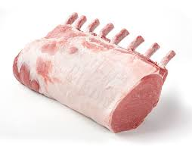




Goods from EU to UK
EU (e.g. Spain)
UK (e.g. Dover)
UK destination
Now
Product enters into UK freely and is placed on the UK market
Post Brexit
Importer notifies UK (FSA) in advance of intention to import High-Risk food and feed.
Product enters into UK freely and is placed on the UK market.
Notes:
SLIDE 2: Imports of HR food and feed into the UK from EU:
Current requirements:
EU origin high-risk food and feed is in free circulation across the whole of the EU, meaning that there are no import controls or requirements when such products travel between EU Member States. Products are free to enter other Member States through any entry point.
Future requirements (In a no-Deal scenario):
There will be no increase in risk from EU origin high-risk food and feed products from Day 1, so will be allowed to enter the UK via any point of entry and will not be subject to UK controls from Day 1.
From June 2019, there will be a requirement for high-risk products to be pre-notified for surveillance purposes (see below).

Slide 40


RoW High-Risk Food and Feed moving through the EU to the UK
RoW to UK via the EU
RoW Origin
Through
the EU
UK sea/air port (BIP/DPE)
UK destination
For RoW high-risk food and feed consignments, the importer will be required to send those products to a UK BIP/DPE for checks to be carried out (as 3rd country process).
List of UK DPEs at:
https://www.food.gov.uk/business-guidance/port-designations
Note: If the goods are imported directly into the EU where the relevant import controls are undertaken, there will be no requirement to enter the UK via a UK BIP/DPE. This means the consignments will be able to enter the UK via any entry point.
Notes:
SLIDE 3: Non-EU high-risk food and feed transits:
Current requirements:
• All non-EU high-risk food and feed products travelling through the EU destined directly for the UK must be pre-notified on TRACES to an EU BIP/DPE where the required controls are undertaken.
• Once the checks are complete and if satisfactory, the consignments can be released to be placed onto the EU market (including the UK) with no further controls or import requirements when transported between different Member States.
Future requirements (In a no-Deal scenario):
• The UK will not be able to rely on the EU undertaking import controls on behalf of the UK, therefore, high-risk food and feed products travelling through the EU destined for the UK must be pre-notified on IPAFFS to a UK BIP/DPE and only enter the UK through a UK BIP/DPE.
• Importers must obtain the necessary certificates, e.g. health certificates and certificates of laboratory analysis, if required, from the competent authority in the exporting country.
• The UK BIP/DPE will undertake the required checks. For POAO these include a mandatory document and identity check and a specified number of physical checks, depending upon the specific commodity. For HRFNAO these include a mandatory document check and a specified frequency of identity and physical checks, depending upon the commodity, hazard and country of origin.
• Once the checks are complete and if satisfactory, the consignments can be released to be placed on the UK market.
• Not all UK entry points have a BIP or a DPE, for example the Channel Tunnel has neither and Dover’s DPE is not approved (or logistically able) to handle the trade arriving from the RoRo terminal at that port. High-risk food and feed products arriving at a port without a BIP/DPE will be non-compliant and as illegal imports will be rejected. This will result in the re-export or destruction of the consignment.

Slide 41
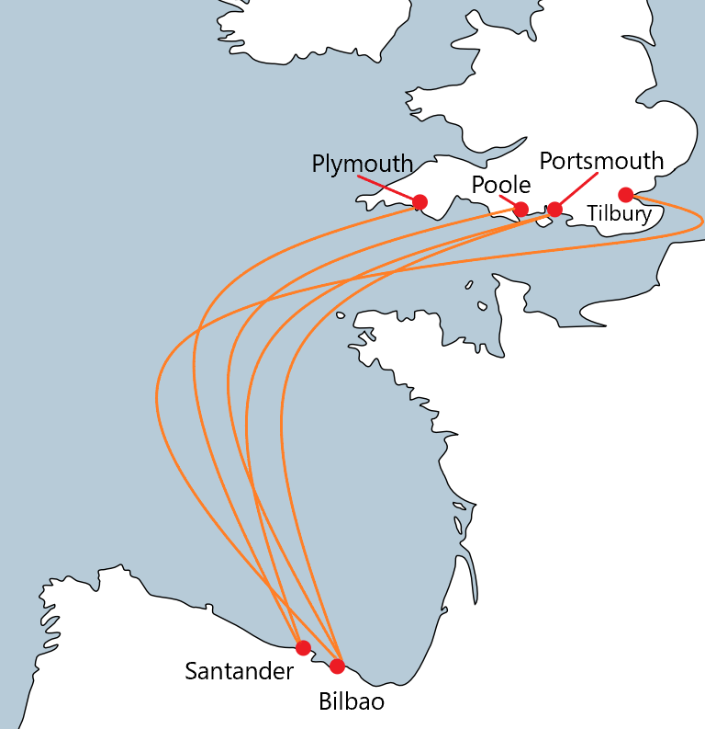
Ferry routes between the UK and Spain
Port Designations
UK:
London Tilbury – BIP & DPE
Portsmouth – DPE
Plymouth – not approved as a BIP/DPE
Poole – not approved as a BIP/DPE
Spain:
Bilbao – BIP & DPE
Santander – BIP
Notes:
SLIDE 2: Imports of HR food and feed into the UK from EU:
Current requirements:
EU origin high-risk food and feed is in free circulation across the whole of the EU, meaning that there are no import controls or requirements when such products travel between EU Member States. Products are free to enter other Member States through any entry point.
Future requirements (In a no-Deal scenario):
There will be no increase in risk from EU origin high-risk food and feed products from Day 1, so will be allowed to enter the UK via any point of entry and will not be subject to UK controls from Day 1.
From June 2019, there will be a requirement for high-risk products to be pre-notified for surveillance purposes (see below).

Slide 42
Pre-notification of EU High-Risk Food and Feed
What
EU originated high-risk food or feed
RoW high-risk food/feed imported directly into the EU but destined for UK
Why
Due to loss of access to EU systems
Ensure the continued protection to UK consumers from imported food
When
Requirement will come into effect during a No Deal scenario
For surveillance purposes only and there will be no controls on such products
More information: Food and feed products not of animal origin that are considered as high-risk: www.food.gov.uk/business-guidance/imports-exports
Notes:
High-risk food and feed products originating from the EU or originating from non-EU countries that have been imported directly into the EU and checked upon entering the EU, will need to be pre-notified to the UK when imported into the UK. This is because, if the UK leaves the EU without a Deal, then it will lose access to EU systems. To ensure the continued protection to UK consumers from imported food, it will be necessary to have an appropriate surveillance capability and to know what high-risk food and feed products from the EU are entering the UK, through which entry points, when and in what volumes.
This is so that in the event of a food incident occurring in a product arriving from the EU, the UK Food Standards Agency will be able to react swiftly with targeted enforcement. This pre-notification will not be from Day 1, as the risks remain the same. It is expected that this requirement will come into effect from June using a new UK system. Ultimately, pre-notification of EU high-risk food and feed will be made using the new IPAFFS system.
Further information and guidance on this pre-notification requirement for high-risk food and feed originating from or imported into the EU will be available in due course.
It is important to remember that this requirement for information on imports from the EU of high-risk food and feed products is for surveillance purposes only and there will be no controls on such products. Importers may also be requested at random to provide evidence that their high-risk food and feed consignments have been properly controlled when imported into the EU.
Further information on what food and feed products not of animal origin are considered as high-risk, as well as details of the UK’s DPEs can be found on the FSA’s website (www.food.gov.uk/business-guidance/imports-exports). Details of UK BIPs can be found on the EU’s website:
https://ec.europa.eu/food/sites/food/files/animals/docs/bips_contact_unitedkingdom.pdf

Slide 43
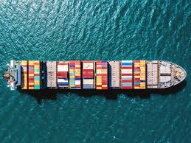
A new UK import notification system
After leaving the EU, the UK will no longer have access to the EU import notification system, TRACES. This system facilitates pre-notification of consignments destined for a UK border inspection post, records the outcome of checks and communicates the outcomes to HMRC for customs clearance.
A UK import notification system (IPAFFS) will be introduced to maintain our levels of biosecurity, minimise delays at borders and allow developments to support the UK’s future import controls.

Slide 44
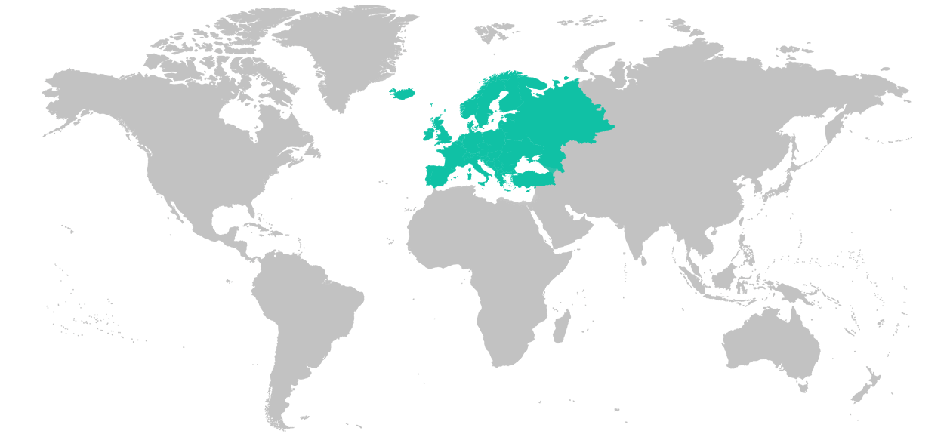
Part 1: importer raises a notification
The importer raises a notification in the new Imports Notification System. The system captures the required information for each commodity type based on the existing certificate types.
Part 1 – 3rd Countries Importers
Live Animals – (CVED-A)
POAO (CVED-P)
High Risk Feed/Food (CED)
Part 1 – EU Member State Importers
Live Animals – (ITAHCs and DOCOMs)
POAO (Pre-notification) – Post Day 1
High Risk Feed/Food (Pre-notification) Post Day 1

Slide 45
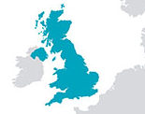
Part 2: conduct checks at the border
Checks are conducted at Border Inspection Posts and the outcomes of these checks are recorded in the system.
Part 2 – 3rd Countries and EU
Checks conducted at the BIPs
Record lab test results
Multiple Commodities
Imposed Physical Check Calculations
HMRC Interface
Once Part 2 is completed, information is passed on to HMRC system CHIEF via an interface with ALVS.
Part 3 – 3rd Countries and EU
Controlled Destinations (CPH)
(This is usually live animals to a farm of products to a processing plant)
HMRC Link – 3rd Countries and EU
Integration to ALVS – Testing Part 1
Integration to ALVS – Testing Part 2

Slide 46
overall_0_131890129951127481 columns_1_131898676008132304 6_1_131889998640165249 9_1_131889998640376058 25_1_131890006548949768 30_1_131890010047522118 33_1_131890010222844276 37_1_131890018140189422 38_1_131890029732408871 44_1_131890068567785038 27_1_131890129739223457 8_1_131892805328226547
Imports to the UK: Live Animals
Check what documents are required for the goods you import across the EU-UK border and how to apply for them.
Pre-notify the UK authorities about the goods you import across the EU-UK border at least 24 hours prior to arrival
Plan with logistics provider for travel to a UK Point of Entry that has the facilities for live animals
Check the systems you need to use and prepare your business to do so
Obtain CITES permit before shipment of CITES compliant specimens or products and enter UK via designated Point of Entry

Slide 47
overall_0_131890129951127481 columns_1_131898676008132304 6_1_131889998640165249 9_1_131889998640376058 25_1_131890006548949768 30_1_131890010047522118 33_1_131890010222844276 37_1_131890018140189422 38_1_131890029732408871 44_1_131890068567785038 27_1_131890129739223457 8_1_131892805328226547
Imports to the UK: Plants & Timber
Check whether the goods you export across the UK-EU border are currently managed under the EU plant passport regime or CITES. If they are, you will need to provide a phytosanitary certificate (PC) and CITES permit to move them to the UK on Day 1.
The UK importer may need to be registered on UK systems or with the UK authorities in order to import into the UK. They should check the systems they need to use (e.g. PEACH) and register before they import.
The UK importer must pre-notify the UK authorities about the goods being imported across the UK-EU border using the PEACH system (for goods entering in England and Wales). They will need to provide scanned copies of the PC and import documents.
Plan with logistics provider for travel via a UK authorised Point of Entry for plants and plant products/timber.
If your goods have come from a 3rd country via the EU and are entering via a RoRo port, arrange inland checks at authorised trade premises.

Slide 48

overall_0_131890129951127481 columns_1_131898676008132304 6_1_131889998640165249 9_1_131889998640376058 25_1_131890006548949768 30_1_131890010047522118 33_1_131890010222844276 37_1_131890018140189422 38_1_131890029732408871 44_1_131890068567785038 27_1_131890129739223457 8_1_131892805328226547
Imports & Exports: Wood Packaging Material
Wood packaging material such as wooden pallets moving between the UK and the EU will have to be heat treated and marked in compliance with international standards.
The UK will continue to take a risk-based approach to checking WPM and therefore there will be no new border checks on EU WPM.

Slide 49
overall_0_131890129951127481 columns_1_131898676008132304 6_1_131889998640165249 9_1_131889998640376058 25_1_131890006548949768 30_1_131890010047522118 33_1_131890010222844276 37_1_131890018140189422 38_1_131890029732408871 44_1_131890068567785038 27_1_131890129739223457 8_1_131892805328226547
Chemicals
The UK will replace EU regulations with a UK regulatory framework and build domestic capacity to deliver the functions currently performed by the European Chemicals Agency (ECHA)
The UK will lose access to the EU’s REACH IT-system
Imports to the UK: For the majority of chemical shipments, there will be minimal impact at points of entry because regulatory control takes place away from the border
Exports to the EU: There are additional requirements for exporters, namely appointing an EU-based Only Representative to maintain access to the EU market, but these do not take place at the border

Slide 50
overall_0_131890129951127481 columns_1_131898676008132304 6_1_131889998640165249 9_1_131889998640376058 25_1_131890006548949768 30_1_131890010047522118 33_1_131890010222844276 37_1_131890018140189422 38_1_131890029732408871 44_1_131890068567785038 27_1_131890129739223457 8_1_131892805328226547
Exports to the EU: Animals and Animal Products
In the event of a ‘No Deal’
The UK will need to be listed as a ‘third country’ to export to the EU. The EU listed the UK as a third country ahead of a potential no-deal on 12 April and we expect we will continue to meet the requirements for ‘third country’ status.
To export animals, animal products, fish, shellfish, crustaceans or fishery products from the UK to the EU, the UK exporter will need a certified export health certificate (EHC), signed by an authorized signatory following an inspection, which is sent with the export consignment
The goods will need to enter the EU through a border inspection post (BIP)
The EU-based importer/import agent will have to notify the BIP prior to the arrival of the consignment, and at least 24 hours in advance for live animals – and upload a copy of the EHC on TRACES

Slide 51
overall_0_131890129951127481 columns_1_131898676008132304 6_1_131889998640165249 9_1_131889998640376058 25_1_131890006548949768 30_1_131890010047522118 33_1_131890010222844276 37_1_131890018140189422 38_1_131890029732408871 44_1_131890068567785038 27_1_131890129739223457 8_1_131892805328226547
Exports to the EU: Animals and Animal Products
Key messages for EU businesses:
Pre-notify on TRACES when importing animals and animal products from the UK – and upload a copy of the UK Export Health Certificate
Ensure the UK exporter sends the original Export Health Certificate (EHC), signed by an authorised signatory, with the consignment
Plan with logistics providers to enter the EU through a BIP
Obtain CITES permit before shipment of CITES compliant specimens or products and enter via designated Point of Entry

Slide 52
overall_0_131890129951127481 columns_1_131898676008132304 6_1_131889998640165249 9_1_131889998640376058 25_1_131890006548949768 30_1_131890010047522118 33_1_131890010222844276 37_1_131890018140189422 38_1_131890029732408871 44_1_131890068567785038 27_1_131890129739223457 8_1_131892805328226547
EU Exit pet travel readiness
Under the current EU Pet Travel Scheme pets can move into & between Member States using an EU pet passport.
This will change when the UK leaves the EU and after any implementation period. The UK will be a third country but pets will still be able to move between the UK to the EU.
There are three classifications of third country: Part 1 listed, Part 2 listed and unlisted. Pets entering EU MSs from the UK will need to meet rules of the relevant classification.
Entry requirements from the EU to the UK will not change. Pets will require a microchip, up-to-date rabies vaccinations and dogs will need a tapeworm treatment if travelling from a tapeworm-free country. The UK will continue to accept EU-issued pet passports as well as animal health certificates.
UK nationals taking pets to Spain will face changes depending on how the UK is classified:
Part 1 listed: Same ID/health rules, Part 1 listed Pet Passports replace EU ones
Part 2 listed: Same ID/health rules, certificates replace pet passports
Unlisted: Same ID, blood test for rabies, certificates replace pet passports
In a Part 2 or Unlisted outcome pets travelling from the UK would need to enter the EU via a Travellers Point of Entry.
EU pets returning from the UK will also need a rabies blood test and to enter the EU via a Travellers Point of Entry.

Slide 53
overall_0_131890129951127481 columns_1_131898676008132304 6_1_131889998640165249 9_1_131889998640376058 25_1_131890006548949768 30_1_131890010047522118 33_1_131890010222844276 37_1_131890018140189422 38_1_131890029732408871 44_1_131890068567785038 27_1_131890129739223457 8_1_131892805328226547
EU Exit pet travel readiness - communications
Headline comms message is: to ensure your pet is able to travel from the UK to the EU after Brexit in any scenario, contact your vet at least 4 months before travelling for the latest advice.
Communications campaign running since Nov 2018 and relaunched in June 2019 to prepare pet owners for potential No Deal Brexit on 31 October.
Guidance on ‘Pet Travel to Europe after Brexit’ live on GOV.UK details how to prepare in all scenarios, including if the UK becomes an unlisted third country.
GOV.UK guidance includes advice for UK nationals living in EU Member States and detailed in FCO’s ‘Living in Spain’ online guide.
Good engagement with the campaign from official carriers and travel industry stakeholders that have helped increase GOV.UK hits and calls to our dedicated Pet Travel helpline.
Information available via Brittany Ferries who have included No Deal pet travel messaging on their website and are sending out advice to passengers due to travel after 31 October.
Airports such as Heathrow Airport have also included Pet Travel No Deal comms on passenger databases, are sharing messaging on social media and via booking pages.

Slide 54

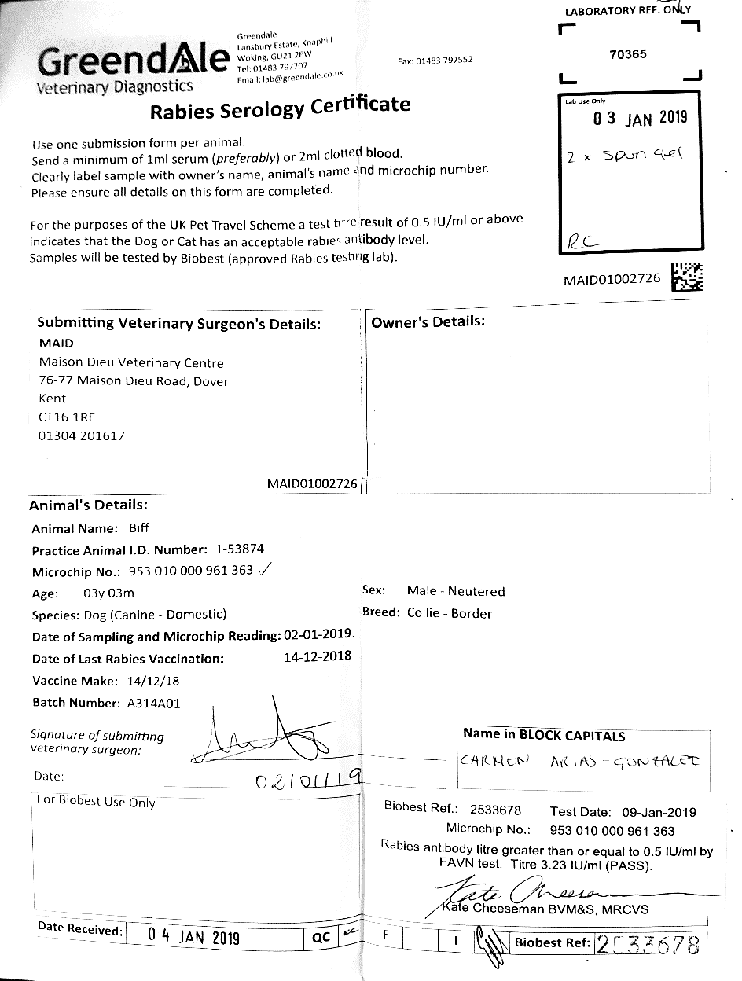
overall_0_131890129951127481 columns_1_131898676008132304 6_1_131889998640165249 9_1_131889998640376058 25_1_131890006548949768 30_1_131890010047522118 33_1_131890010222844276 37_1_131890018140189422 38_1_131890029732408871 44_1_131890068567785038 27_1_131890129739223457 8_1_131892805328226547
EU Exit pet travel readiness – Heather’s dog

Slide 55
overall_0_131600703271538582 columns_1_131600694444874709
Any questions

Slide 56
Department for Transport
Bethan Grinham - Roads EU Exit, DfT

Slide 57
Prepare your business now to ensure you, your customers and suppliers are ready for EU Exit
overall_1_131909330706806068 columns_6_131909333956719804 23_1_131898766477144216 24_1_131898766508304422 33_1_131898767018609914 8_1_131909330056234927 17_1_131909330464163844 31_1_131909330464595005 32_1_131909330779556429 37_1_131909333640865797
“The UK wants to explore options for reciprocal access for road hauliers and passenger road transport operators, and arrangements for private motoring” - UK White Paper, July 2018
“The Parties should ensure comparable market access for freight and passenger road transport operators […] Parties should consider complementary arrangements to address travel by private motorists”
- Political Declaration, November 2018

Slide 58

Prepare your business now to ensure you, your customers and suppliers are ready for EU Exit
overall_1_131909330706806068 columns_6_131909333956719804 23_1_131898766477144216 24_1_131898766508304422 33_1_131898767018609914 8_1_131909330056234927 17_1_131909330464163844 31_1_131909330464595005 32_1_131909330779556429 37_1_131909333640865797
Transport documentation for EU hauliers will remain the same, with no new documents or processes.
The UK Government has confirmed it will:
Continue with existing driver hour arrangements
Recognise driver and transport manager Certificate of Professional Competence (CPC)
Recognise EU issued driving licences
Recognise EU Community licence – you will not need an ECMT permit to access the UK
In the event of a no deal, you will require either a Green Card or other proof of Insurance, as set out in UK legislation. If you have different policies for your trailer and vehicle – please bring proof of insurance for each.
As the EU Regulation on maintaining basic connectivity has now been approved, the UK put in place laws to reciprocate:
We will maintain the current rights for EU hauliers and bus operators after exit day, including on cabotage and cross-trade

Slide 59
Prepare your business now to ensure you, your customers and suppliers are ready for EU Exit
overall_1_131909330706806068 columns_6_131909333956719804 23_1_131898766477144216 24_1_131898766508304422 33_1_131898767018609914 8_1_131909330056234927 17_1_131909330464163844 31_1_131909330464595005 32_1_131909330779556429 37_1_131909333640865797
Drivers Hours
Department for Transport is able to respond rapidly to urgent situations by temporarily relaxing the drivers’ hours rules where it is in the public interest to do so.
The details, including the scope of the relaxation, are determined on a case-by-case basis following close engagement with affected industry sectors.
In the past this facility has been made use of during roads disruption caused by events such as adverse weather conditions and disruption to cross-Channel traffic.
Driver CPC
The EU has indicated that UK-issued CPC will not be recognised for employment in the EU.
Holders of a UK Driver CPC who are currently working for an EU company may want to exchange their UK CPC for an EU CPC before Exit Day.
Exchanging CPC in this way will have no effect on a driver’s ability to work in the UK because the UK will continue to recognise EU-issued CPC.

Slide 60
Prepare your business now to ensure you, your customers and suppliers are ready for EU Exit
What is Operation Brock?
Operation Brock is a set of measures to keep the M20 open in both directions between junctions 8 and 9 in the event of disruption to services across the English Channel, by using different holding areas. The queuing system only applies to lorries heading to mainland Europe from Kent. All other drivers should check conditions before setting out and, if they’re crossing the channel, check with their service operator for updates. This is all predicated on the French traffic management system which enables them to keep their networks open in all directions.
Phase 1 In the event of excessive disruption to services across the English Channel, improved holding capacity in the Port of Dover and Eurotunnel, as well as on the A20 approach to the port (Dover TAP), would be used.
Phase 4 If the M20 holding area and Manston becomes full, the M26 could be used to hold additional lorries heading for Eurotunnel.
Phase 2 If phase 1 capacity is reached, we will start queuing Europe bound lorries that are 7.5 tonnes and over on the coast bound section of the M20 between junction 8 and 9 with cars and other vehicles using a contraflow on the London-bound carriageway.
Phase 3 If phase 2 becomes full, lorries heading for Port of Dover will be directed to Manston Airfield, while the M20 is used to hold traffic for Eurotunnel. Traffic lights on the A256 after Manston Airfield will help to manage traffic travelling to the port.
Further information can be found on https://highwaysengland.co.uk/OperationBrock/

Slide 61
overall_0_131600703271538582 columns_1_131600694444874709
Any questions

Slide 62
Department for Business, Energy and Industrial Strategy
Danny Langley – Trade and Investment Negotiations

Slide 63

Existing regulation of 'New Approach' goods
High-level requirements in legislation and use of harmonised standards to achieve compliance.
Conformity with requirements of ‘New Approach’ legislation shown by use of the CE marking.
In most cases manufacturers take sole legal responsibility for compliance and can self-declare.
In other cases manufacturers need to use a third party assessment body (a ‘notified body’).

Slide 64

Selling goods into the UK
New approach goods meeting EU regulations and CE marked can still be sold in UK for time-limited period.
UK will directly recognise conformity assessment carried out by EU notified bodies.
A new UK database will replace the EU’s NANDO database.
Products assessed against UK rules by a UK ‘approved body’ will need the UKCA marking.
We will consult with businesses before making any changes to these arrangements.

Slide 65
Other issues to consider
EU-based authorised representatives who received their mandate pre-exit day recognised in UK.
An UK-based distributor of EU goods may become an ‘importer’ – and vice-versa.
Compared to a distributor, importers have a stronger duty to ensure products are compliant.
The importer’s address also often has to be put on the product or its packaging.
Different arrangements apply to medical devices.

Slide 66



Arrangements for other goods
The UK will have it’s own REACH regime post exit for chemicals manufactured in or exported to the UK.
EC type-approvals no longer automatically accepted for motor vehicles on the UK market – the UK Vehicle Certification Agency (VCA) will issue provisional UK type approvals.
Medicines with a 'centralised' authorisation will be given a UK authorisation.
In various areas (cosmetics, chemicals, medicines) - companies may need to appoint new UK representatives.
Exact arrangements will depend on specific goods – lots of guidance available on GOV.UK.

Slide 67
Non-harmonised goods
Products subject to national rather than EU-wide rules can sometimes be sold freely across the EU by virtue of the ‘mutual recognition principle’.
UK will no longer be within scope of the mutual recognition principle after Exit.
April 2020: updated 'Mutual Recognition Regulation' will come into force in the EU but will not apply to UK​.
If you export these goods to the UK you must check they meet UK national requirements.

Slide 68
Automotive manufacturers: how things work today
Safety and environmental standards for vehicle and component manufacturer type-approvals are set in framework regulations on ECWVTA.
UK Vehicle Certification Agency (VCA) issues EU-recognised type-approvals, and acts as a technical service for compliance testing.
The UK is an individual contracting member to the UN-ECE, and continues to recognise UN-ECE approvals for vehicle systems and components.
1. European Community Whole Vehicle Type Approval

Slide 69
Automotive: checklist of actions for selling into the UK
Motor vehicles to be placed on the UK market will need to convert their existing EC type-approvals to UK type-approval by applying to VCA for a provisional UK type-approval.
New vehicle approvals will require VCA-issued UK type-approval after exit day (subject to new legislation which will come into force in Autumn 2019).
For manufacturers with valid EC type-approval post exit: duplicate testing is not required, but manufacturers will need to supply documentary evidence to prove compliance.
Read the detailed guidance on gov.uk.

Slide 70


Other issues – travel, data transfers and geo-blocking
EU/EEA/Swiss citizens will still be able to enter the UK for up to 3 months at a time, to work, visit or study, without requiring a visa.
EEA based businesses can transfer personal data to the UK in 'No Deal' if ‘appropriate safeguards’ under GDPR are used (such as standard contractual clauses).
As the geo-blocking regulation will no longer apply, traders from UK, EU and 3rd countries can offer different terms to UK customers compared to EU customers.

Slide 71
Helping to Prepare Your Business
Stella Jarvis – Director, Border Delivery Group
Heather Jones – Deputy Director, Border Deliver Group, SouthEast & Europe

Slide 72









Your next steps on GOV.UK
1
2
Answer seven questions to be directed to relevant content.
Choose one of the nine themes you are most interested in.
Find out more
3
4
Sign up to email alerts about EU exit on GOV.UK:
Brexit email alerts.
Download this leaflet on preparing your business for EU exit and the government’s every day support for business.

Slide 73
Additional information
overall_1_131909330706806068 columns_6_131909333956719804 23_1_131898766477144216 24_1_131898766508304422 33_1_131898767018609914 8_1_131909330056234927 17_1_131909330464163844 31_1_131909330464595005 32_1_131909330779556429 37_1_131909333640865797
Available products
Partnership Pack: a pack designed to help support businesses preparing for day one if we leave the EU without a Deal.
Communication products are currently being updated to include a range of materials that can be used to raise awareness with your own stakeholders and customers. These include:
Leaflets: covering the key changes in a No Deal scenario, for a range of industries
Videos: covering the key changes and additional requirements, including short clips designed for social media and deep dive videos into key topics such as importing and exporting
Border Delivery Group have set up a dedicated email address (below) for questions about the border and Brexit preparedness. Please also contact BDG to sign up for email updates covering new information related to EU Exit.
queriesattheborder.euexit@hmrc.gov.uk
BDG have also developed a Frequently Asked Questions product which will be shared with you following today’s event.

Slide 74
Additional information
Key elements of EU27 comms activities for the border include:
The European Commission produced a guide for businesses on “How To Prepare For Brexit” and published on 12 June 2019 their contingency paper, available at:
https://ec.europa.eu/taxation_customs/sites/taxation/files/leaflet-brexit-customs-guide-for-businesses_en.pdf
The Spanish Government has published a Brexit web page to disseminate information on preparedness and contingency planning at:
https://www.lamoncloa.gob.es/lang/en/brexit/Paginas/index.aspx
The French Government have published products including short videos and physical paper products at:
http://www.douane.gouv.fr/articles/c958-brexit
Notes:
There are a number of very useful products and communication channels available to help you to prepare your business

Slide 75
Summary of key actions for goods leaving the UK
overall_0_131914171178850193 columns_6_131909337290464816 33_1_131898834872320020 6_1_131909978362560231 12_1_131909978478659975 8_1_131909978478870582 23_1_131909978704642670 26_1_131909979882896884
Register for an EORI number with the UK.
If exporting, the Export Declaration and S&S Declaration are merged. If using transit it is also merged.
Review the information needed for entry into the EU – if you are not using transit, your haulier will also be required to carry evidence (the MRN) of an EU Member States pre-lodged import and separate Safety & Security Declarations.
Agree responsibilities with your customs agent and/or logistics provider for each part of the process and update your contracts to reflect this or identify software to utilise.
Apply in advance for ID documents and/or certificates for goods.
Ensure the UK exporter sends required documentation for the goods imported with consignment, such as Export Health Certificates (EHC).
Pre-notify systems where required, such as TRACES when importing animals and animal products from the UK and uploading a copy of the UK Export Health Certificate.

Slide 76
Summary of key actions for goods entering the UK
overall_0_131914171178850193 columns_6_131909337290464816 33_1_131898834872320020 6_1_131909978362560231 12_1_131909978478659975 8_1_131909978478870582 23_1_131909978704642670 26_1_131909979882896884
Register for an EORI number with home country’s customs office; UK importer must have a UK EORI number.
Apply for a deferment account if you are eligible.
Review the information needed for the Declaration forms, and review easements allowed for Transitional Simplified Procedures (TSP).
Check the systems (e.g. UK Import System, IPAFFS) you need to use and prepare to do so.
Agree responsibilities with your customs agent and/or logistics provider for each part of the process and update your contracts to reflect this, or identify software to utilise.
Apply in advance for ID documents and/or certificates for goods.
Ensure the UK exporter sends required documentation for the goods imported with consignment, such as Export Health Certificates (EHC).
Plan logistics for travel via inland locations, including goods which are required to enter the UK via Border Inspection Posts (BIP) & Designated Points of Entry (DPE).

Slide 77
overall_0_131600703271538582 columns_1_131600694444874709
Any questions

Slide 78
Industry – Short Straits Operators Panel
Eurotunnel – Jo Willacy
Brittany Ferries – Steve James
DFDS Ferries
P&O Ferries – Alex Cork

Slide 79
P&O Ferries
Alex Cork – Programme Director/Transformation

Slide 80
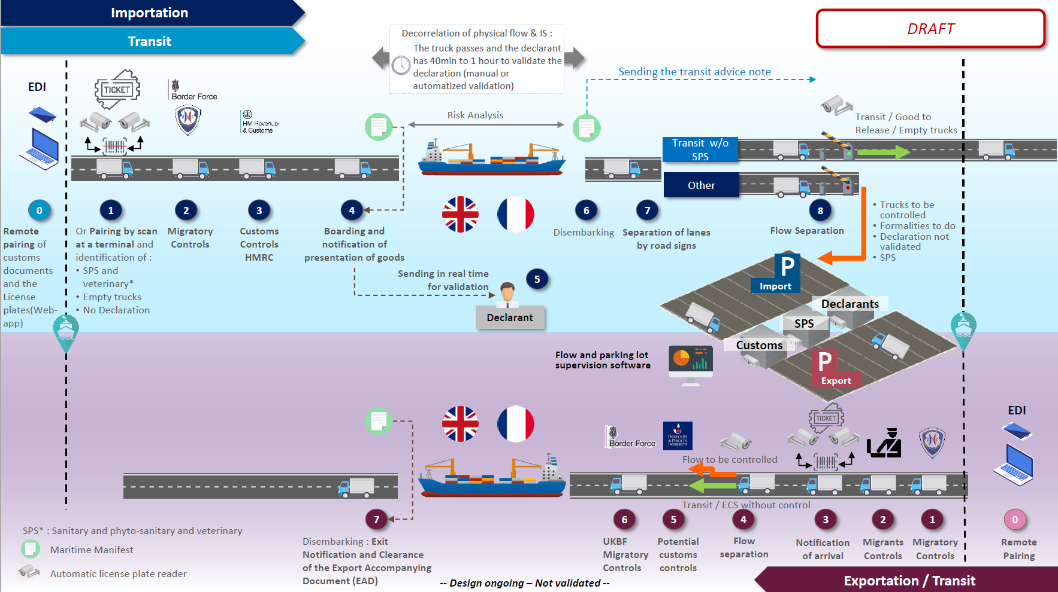

Slide 81
